Slide 1

INT 222 - Advanced Web Development
Lecture #0
Welcome !!!

Slide 2
Assessment/Evaluation Scheme
ATTENDANCE: 5%
CA: 45%
MTT: NO MTT
ETT: 50%

Slide 3
Assessment/Evaluation Scheme
CA 1 – Code Based Test (30 MARKS)
CA 2 – Code Based Test (30 MARKS)
CA 3 – Project (MANDATORY) (30 MARKS)
NOTE: The CA3 will be allocated in 3rd Week and student will submit it in 11th Week.
ETE – End Term Practical's (100 MARKS)

Slide 4
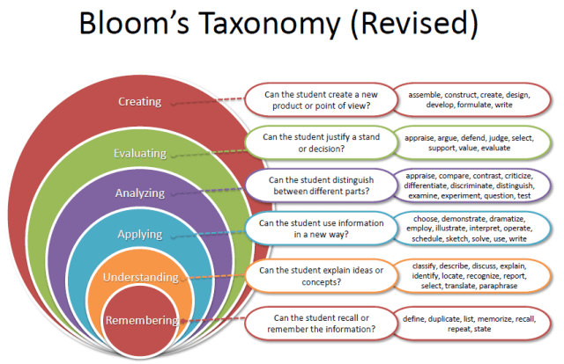
REVISED BLOOM’S TAXONOMY

Slide 5
Course Details
L:2 T:0 P:2 Credits:3
Course Outcome’s:
CO1 :: Describe server-side JavaScript in web application development
CO2 :: Analyze the web application development using HTTP, FS and Buffer modules
CO3 :: Assess the node express, JSON, Socket.IO to allow high scalability with asynchronous code
Notes:
HTML – structure of web page
CSS – design of web page
JavaScript – interactive web pages
Node js – it is the same JavaScript outside web browser

Slide 6
Course Details
L:2 T:0 P:2 Credits:3
CO4 :: Demonstrate the use of CRUD application using Backend database in web application development
CO5 :: Use MongoDB database with Node.js
CO6 :: Construct rich interactive environments for the Web-based applications
Notes:
HTML – structure of web page
CSS – design of web page
JavaScript – interactive web pages
Node js – it is the same JavaScript outside web browser

Slide 7
Program Outcomes
PO1 Engineering knowledge: Apply the knowledge of mathematics, science, engineering fundamentals, and an engineering specialization to the solution of complex engineering problems.
PO2 Problem analysis::Identify, formulate, research literature, and analyze complex engineering problems reaching substantiated conclusions using first principles of mathematics, natural sciences, and engineering sciences.
PO3 Design/development of solutions::Design solutions for complex engineering problems and design system components or processes that meet the specified needs with appropriate consideration for the public health and safety, and the cultural, societal, and environmental considerations.
PO4 Conduct investigations of complex problems::Use research-based knowledge and research methods including design of experiments, analysis and interpretation of data, and synthesis of the information to provide valid conclusions.

Slide 8
Program Outcomes
PO5 Modern tool usage::Create, select, and apply appropriate techniques, resources, and modern engineering and IT tools including prediction and modeling to complex engineering activities with an understanding of the limitations.
PO6 The engineer and society::Apply reasoning informed by the contextual knowledge to assess societal, health, safety, legal and cultural issues and the consequent responsibilities relevant to the professional engineering practice.
PO7 Environment and sustainability::Understand the impact of the professional engineering solutions in societal and environmental contexts, and demonstrate the knowledge of, and need for sustainable development.
PO8 Ethics::Apply ethical principles and commit to professional ethics and responsibilities and norms of the engineering practice.
PO9 Individual and team work::Function effectively as an individual, and as a member or leader in diverse teams, and in multidisciplinary settings.

Slide 9
Program Outcomes
PO10 Communication::Communicate effectively on complex engineering activities with the engineering community and with society at large, such as, being able to comprehend and write effective reports and design documentation, make effective presentations, and give and receive clear instructions.
PO11 Project management and finance::Demonstrate knowledge and understanding of the engineering, management principles and apply the same to one’s own work, as a member or a leader in a team, manage projects efficiently in respective disciplines and multidisciplinary environments after consideration of economic and financial factors.
PO12 Life-long learning::Recognize the need for, and have the preparation and ability to engage in independent and life-long learning in the broadest context of technological change.
PO13 Competitive Skills::Ability to compete in national and international technical events and building the competitive spirit along with having a good digital footprint.

Slide 10
UNIT1
Getting Started with Node.JS : Introducing Node.JS, Node Pacakage Manager (npm), Custom NPMmodules,, Installing Node, use Node.js REPL, Explore and use built-in modules of Node.js, Use of Node.JS and GitHub, collaborate on code with others using the git tool
JavaScript Primer : Defining Variables and their Scope, Understanding JavaScript Data Types, Working with Operators and Loops, Creating Functions, JavaScript Objects, Working with Arrays, Adding Error Handling, Using Events, Listeners, Timers and Callbacks.

Slide 11
UNIT II
Handling Data I/O in Node.js : Working with fs module, Working with JSON, Using Buffer Module to Buffer Data, Using Stream Module to Stream Data, Compressing and Decompressing Data with Zlib.
Implementing HTTP Services in Node.JS: Introduction to HTTP module, Processing URLs, Processing Query Strings and Form Parameters, Understanding Request , Response and Server Objects

Slide 12
UNIT III
Basic Websites With Node.JS : Introducing Express, More on Express, GET, POST, bodyParser .
Creating Middleware with Connect : What is Middleware?, Middleware in Connect, Access Control with Middleware
Socket Services in Node.js: Understanding Network Sockets, A Socket.IO Chat Server, , A Streaming Twitter Client

Slide 13
UNIT IV
Introduction to Backend: : Introduction to PostgreSQL database, Basics of the CRUD pattern., Build application using CRUD, Add User Interface for To-do Application, Convert visual design into working HTML and CSS, Sequelize association, migration and validation.

Slide 14
UNIT V
Getting Started with MongoDB : Understanding MongoDB and Its Data Types, Building the MongoDB Environment, Connecting to MongoDB from Node.js, Accessing and Manipulating Databases, Accessing and Manipulating Collections, Administering Databases, Managing Collections.

Slide 15
UNIT VI
Debugging, Testing and Deploying : Debugging Node.js Applications, Testing Node.js Applications, Deploying Node.js Applications

Slide 16
List of PracticalS
Create JavaScript Objects and functions
Working with the arrays
Assessing file system from Node.js
Create a basic website using node.js
Implementing HTTP Services in Node.JS
Implementing Socket Services in Node.js
Use Jason API website development
Building the MongoDB Environment and Administering Databases

Slide 17
BOOKS
Text Book: PROFESSIONAL NODE.JS: BUILDING JAVASCRIPT BASED SCALABLE SOFTWARE by PEDRO TEIXEIRA, WILEY
References: 1. SAMS TEACH YOURSELF NODE.JS IN 24 HOURS by GEORGE ORNBO, SAMS PUBLISHING
2. LEARN POSTGRESQL by LUCA FERRARI, ENRICO PIROZZI, PACKT PUBLISHING

Slide 18
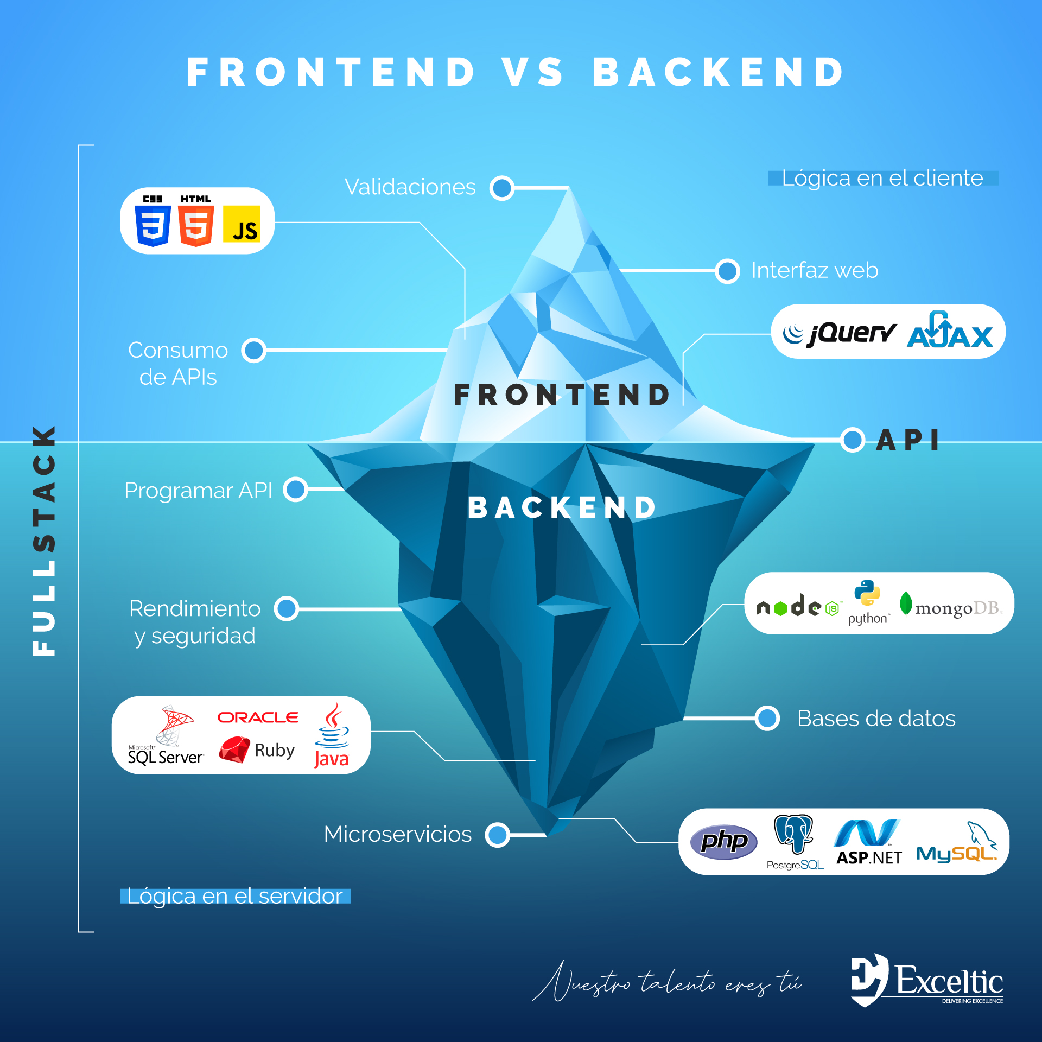

Slide 19

BRIEF INTRO TO Node.js
Node.js was developed by Ryan Dahl in 2009.
Node.js is an open source, cross-platform run time environment to execute JavaScript code outside of a browser.

Slide 20
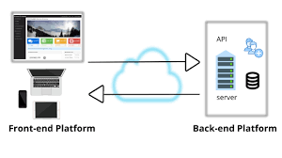

Slide 21
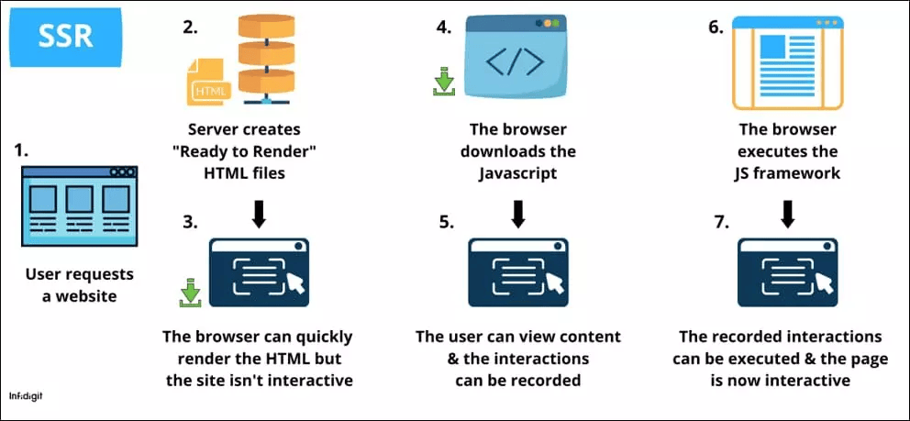

Slide 22
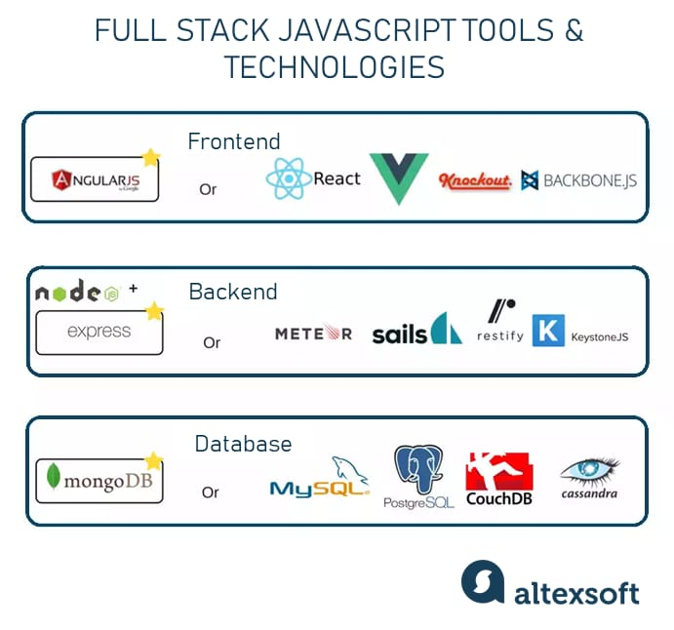

Slide 23
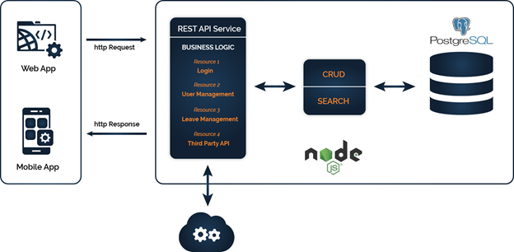

Slide 24
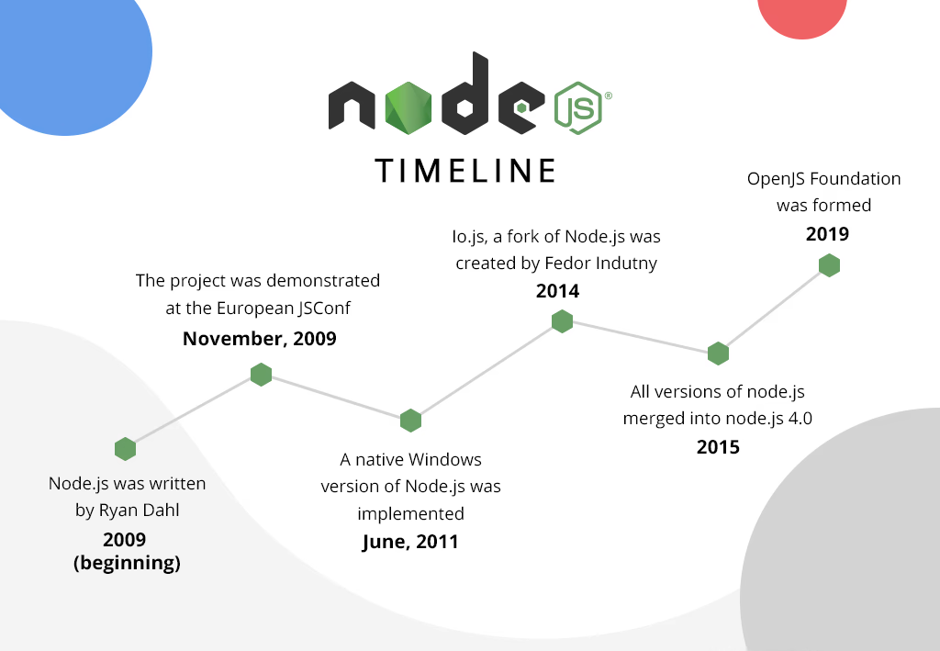
timeline

Slide 25
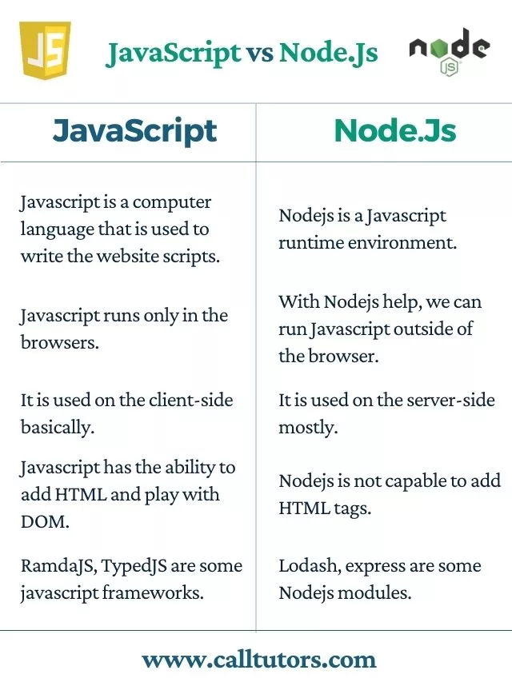

Slide 26
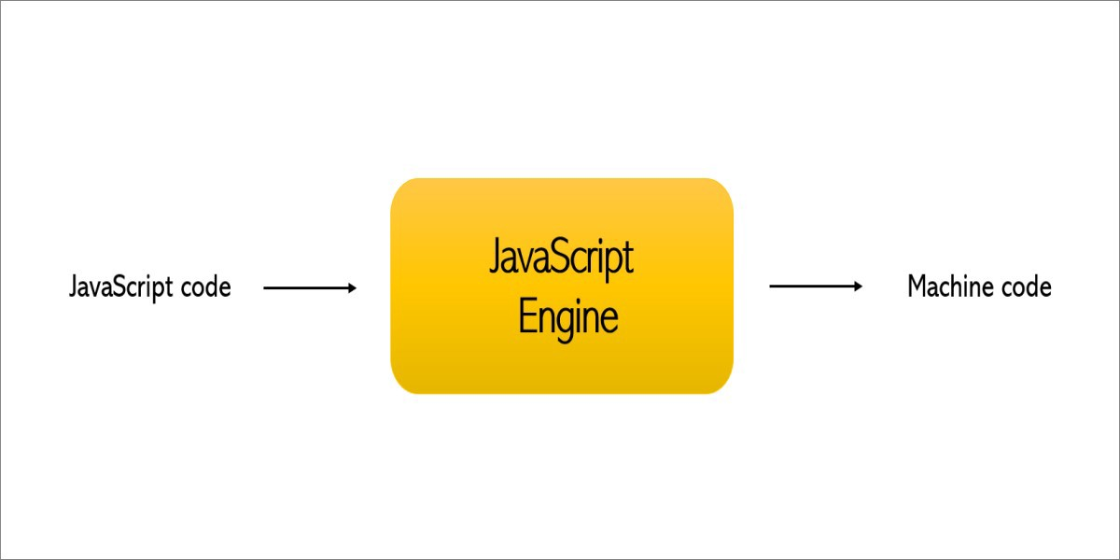
Node.js(contd.)
Node.js is a JavaScript runtime built on Chrome's V8 JavaScript engine.
A JavaScript engine is a program which executes JavaScript code.

Slide 27
Node.js(contd.)
V8 — open source, developed by Google, written in C++
Rhino — managed by the Mozilla Foundation, open source, developed entirely in Java
Chakra — Microsoft Edge

Slide 28
Node.js(contd.)
Why was the V8 Engine created?
The V8 Engine which is built by Google is open source and written in C++.
This engine is used inside Google Chrome.
Unlike the rest of the engines, however, V8 is also used for the popular Node.js runtime.

Slide 29
Node js architecture
Chrome
Node js
V8
V8
Notes:
Before node js, we had the JavaScript apps that would run only inside a browser. Every browser has a JS Engine that takes the JS code and converts it into a code that a computer can understand. In 2009, Ryan Dahl came up with an idea to execute JS code outside of a browser, so he took the Google’s V8 engine(fastest engine) and then embedded it inside a C++ code. So, Node js actually consists of a JS engine to execute the JS code.
But we have different objects in Node js, not like document or window object as we have in browsers. Eg, we can have fs.readFile(), http.createServer().
So node js contains V8 engine and some additional capabilities which are not possible with a browser. Both Chrome and browser share the same JS engine but provide different run time environment to run JS. Node is a run time environment and not a programming language or a framework.

Slide 30
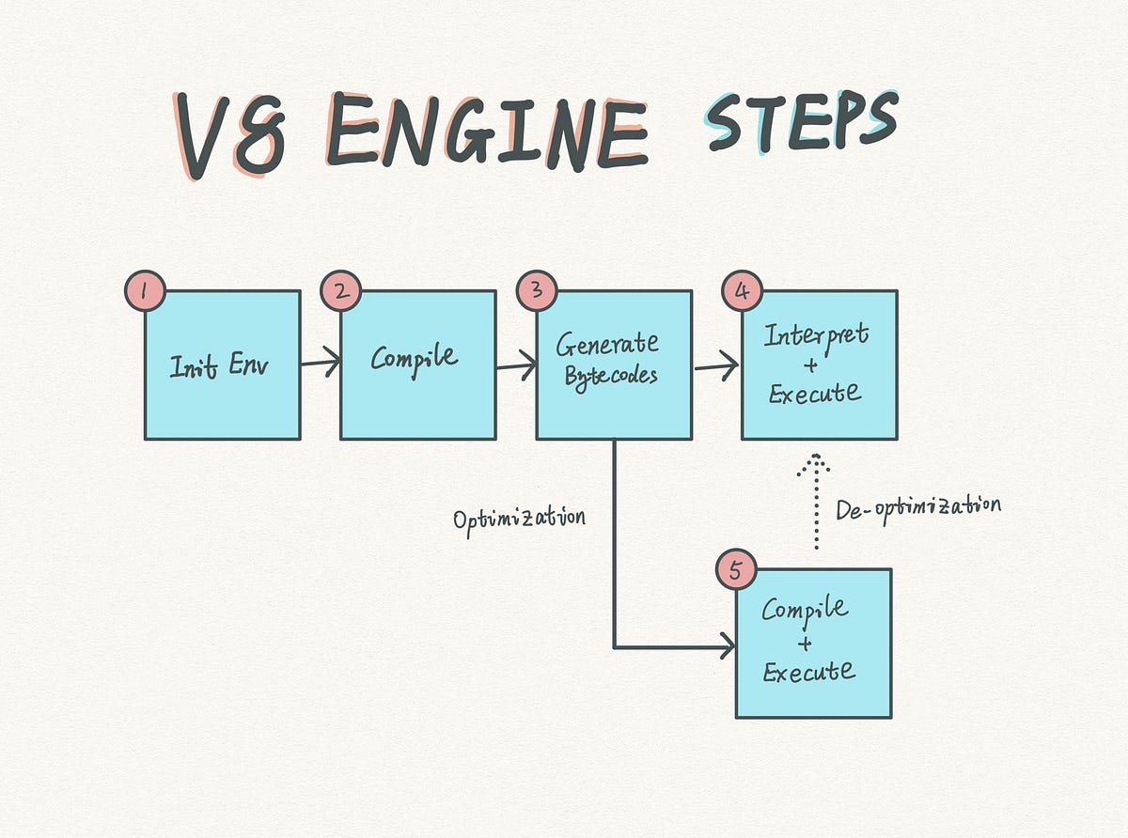

Slide 31
Traditional web server model
In the traditional web server model, each request is handled by a dedicated thread from the thread pool.
If no thread is available in the thread pool at any point of time then the request waits till the next available thread.
Dedicated thread executes a particular request and does not return to thread pool until it completes the execution and returns a response.

Slide 32
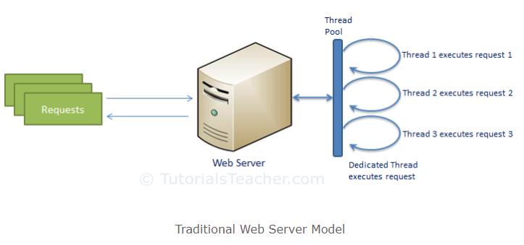
Traditional web server model(contd.)

Slide 33
Node.js model
Node.js processes user requests differently when compared to a traditional web server model.
Node.js runs in a single process and the application code runs in a single thread and thereby needs less resources than other platforms.
All the user requests to your web application will be handled by a single thread and all the I/O work or long running job is performed asynchronously for a particular request.

Slide 34
Node.js model(contd.)
So, this single thread doesn't have to wait for the request to complete and is free to handle the next request.
When asynchronous I/O work completes then it processes the request further and sends the response.
An event loop is constantly watching for the events to be raised for an asynchronous job and executing callback function when the job completes.

Slide 35
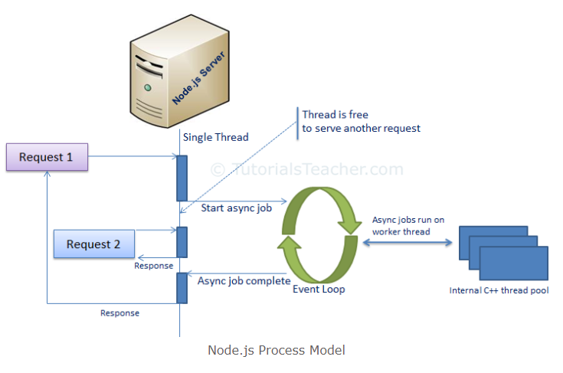
Node.js model(contd.)

Slide 36
Node.js model is asynchronous
A common task for a web server can be to open a file on the server and return the content to the client.
Here is how PHP or ASP handles a file request:
Sends the task to the computer's file system.
Waits while the file system opens and reads the file.
Returns the content to the client.
Ready to handle the next request.

Slide 37
Node.js model is asynchronous(contd.)
Here is how Node.js handles a file request:
Sends the task to the computer's file system.
Ready to handle the next request.
When the file system has opened and read the file, the server returns the content to the client.
Node.js eliminates the waiting, and simply continues with the next request.
Node.js runs single-threaded, non-blocking, asynchronously programming, which is very memory efficient.

Slide 38
Applications using node.js
Netflix
Paypal
LinkedIn
Yahoo
Mozilla
Uber
Ebay
Walmart
NASA

Slide 39
Features of node.js
Asynchronous and Event Driven − All APIs of Node.js library are asynchronous, that is, non-blocking. It essentially means a Node.js based server never waits for an API to return data. The server moves to the next API after calling it.
Very Fast − Being built on Google Chrome's V8 JavaScript Engine, Node.js library is very fast in code execution.

Slide 40
Features of node.js(contd.)
Single Threaded but Highly Scalable − Node.js uses a single threaded model with event looping. Event mechanism helps the server to respond in a non-blocking way and makes the server highly scalable as opposed to traditional servers which create limited threads to handle requests. Node.js uses a single threaded program and the same program can provide service to a much larger number of requests than traditional servers like Apache HTTP Server.

Slide 41
Features of node.js(contd.)
No Buffering − Node.js applications never buffer any data. These applications simply output the data in chunks.

Slide 42
Advantages of Node.js
Uses JavaScript to build entire server side application.
Lightweight framework that includes bare minimum modules. Other modules can be included as per the need of an application.
Performs faster than other frameworks.
Cross-platform framework that runs on Windows, MAC or Linux

Slide 43
Where not to use Node.js
Node.js is not fit for an application which performs CPU-intensive operations like image processing or other heavy computation work because it takes time to process a request and thereby blocks the single thread.

Slide 44
NEXT CLASS
UNIT 1 - Getting Started with Node.JS

